Slide 1
Calibration, Noise, Interference and Grounding
By
Candida Nakida Mwisomba

Slide 2
Control of calibration environment
Any instrument that is used as a standard in calibration procedures must be kept solely for calibration duties and must never be used for other purposes. Most particularly, it must not be regarded as a spare instrument that can be used for process measurements if the instrument normally used for that purpose breaks down.
Proper provision for process instrument failures must be made by keeping a spare set of process instruments. Standard calibration instruments must be totally separate.
To ensure that these conditions are met, the calibration function must be managed and executed in a professional manner. This will normally mean setting aside a particular place within the instrumentation department of a company where all calibration operations take place and where all instruments used for calibration are kept.
As far as possible this should take the form of a separate room, rather than a sectioned-off area in a room used for other purposes as well.

Slide 3
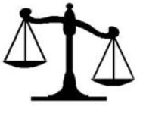
MEASUREMENT STANDARDS
A standard of measurement is physical representation of a unit of measurement.
Standard means know accurate measure of a physical quantity. e.g. unit of mass: Kg

Slide 4
MEASUREMENT STANDARDS
TYPES OF STANDARDS
1. International standards
2. Primary standards
3. Secondary standards
4. Working standards

Slide 5
MEASUREMENT STANDARDS
1. International standards
These standards are maintained at the International bureau of weights and measures and are periodically evaluated and checked by absolute measurements.
There standards are not available for ordinary users for calibration
For accuracy they are replaced by absolute units which are more accurate than international standards

Slide 6
MEASUREMENT STANDARDS
2. Primary standards
They are maintained at national standard laboratories in different countries.
These standards represents fundamental units as well as electrical and mechanical derived units calibrated by absolute measurement at each national laboratories.
Used for calibration and verification of secondary standards.

Slide 7
MEASUREMENT STANDARDS
4. Working standards
These are basic tools for measurement laboratory.
Used to check and calibrate for accuracy.
e.g. resistor industry maintain a standard resistor for checking the values of manufactured resistor

Slide 8
Calibration chain and traceability…
The calibration facilities provided within the instrumentation department of a company provide the first link in the calibration chain. Instruments used for calibration at this level are known as working standards.
As such working standard instruments are kept by the Instrumentation Department of a Company solely for calibration duties, and for no other purpose, then it can be assumed that they will maintain their accuracy over a reasonable period of time because use-related deterioration in accuracy is largely eliminated.
over a longer term, a program must be instituted for calibrating working standard instruments at appropriate intervals of time against instruments of yet higher accuracy. The instrument used for calibrating working standard instruments is known as a secondary reference standard.
This must obviously be a very well engineered instrument that gives high accuracy and is stabilized against drift in its performance with time.

Slide 9
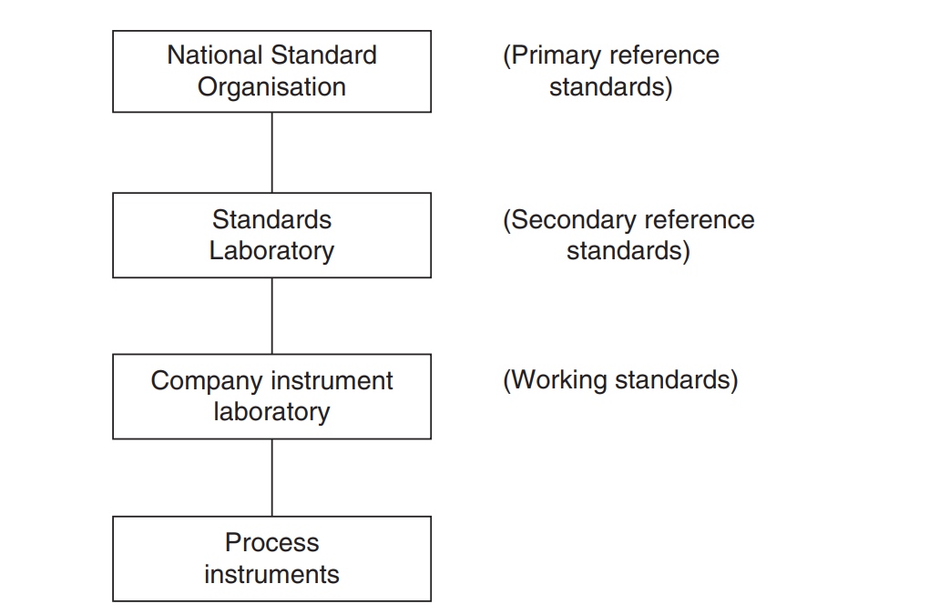
Calibration chain and traceability

Slide 10
Calibration Records
An essential element in the maintenance of measurement systems and the operation of calibration procedures is the provision of full documentation.
This must give a full description of the measurement requirements throughout the workplace, the instruments used, and the calibration system and procedures operated. Individual calibration records for each instrument must be included within this.

Slide 11
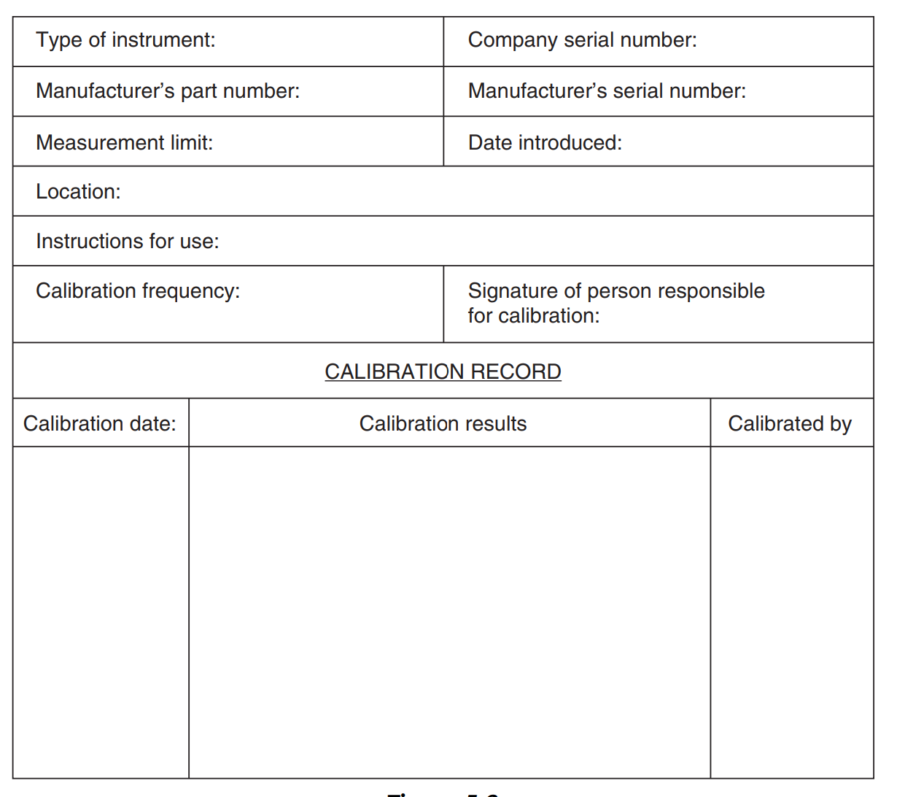
Calibration Records…

Slide 12
QUESTIONS
???

Slide 13
CALIBRATION
Calibration consists of comparing the output of the instrument or sensor under test against the output of an instrument of known accuracy when the same input (the measured quantity) is applied to both instruments.
This procedure is carried out for a range of inputs covering the whole measurement range of the instrument or sensor.
Calibration ensures that the measuring accuracy of all instruments and sensors used in a measurement system is known over the whole measurement range, provided that the calibrated instruments and sensors are used in environmental conditions that are the same as those under which they were calibrated.
For use of instruments and sensors under different environmental conditions, appropriate correction has to be made for the ensuing modifying inputs.

Slide 14
PRINCIPLES OF CALIBRATION
Instruments used as a standard in calibration procedures are usually chosen to be of greater inherent accuracy than the process instruments that they are used to calibrate.
Because such instruments are only used for calibration purposes, greater accuracy can often be achieved by specifying a type of instrument that would be unsuitable for normal process measurements.
Instrument calibration has to be repeated at prescribed intervals because the characteristics of any instrument change over a period.
Changes in instrument characteristics are brought about by such factors as mechanical wear, and the effects of dirt, dust, fumes, chemicals and temperature changes in the operating environment.

Slide 15
PRINCIPLES OF CALIBRATION…
Determination of the frequency at which instruments should be calibrated is dependent upon several factors that require specialist knowledge.
If an instrument is required to measure some quantity and an inaccuracy of ±2% is acceptable, then a certain amount of performance degradation can be allowed if its inaccuracy immediately after recalibration is ± 1%.
What is important is that the pattern of performance degradation be quantified, such that the instrument can be recalibrated before its accuracy has reduced to the limit defined by the application.

Slide 16
PRINCIPLES OF CALIBRATION…
Susceptibility to the various factors that can cause changes in instrument characteristics varies according to the type of instrument involved.
Possession of an in-depth knowledge of the mechanical construction and other features involved in the instrument is necessary in order to be able to quantify the effect of these quantities on the accuracy and other characteristics of an instrument.
A proper course of action must be defined that describes the procedures to be followed when an instrument is found to be out of calibration, i.e. when its output is different to that of the calibration instrument when the same input is applied.

Slide 17
PRINCIPLES OF CALIBRATION…
Whatever system and frequency of calibration is established, it is important to review this from time to time to ensure that the system remains effective and efficient.
It may happen that a cheaper (but equally effective) method of calibration becomes available with the passage of time, and such an alternative system must clearly be adopted in the interests of cost efficiency.
As the environmental and usage conditions of an instrument may change beneficially as well as adversely, there is the possibility that the recommended calibration interval may decrease as well as increase.

Slide 18
Control of calibration environment …
Calibration procedures that relate in any way to measurements that are used for quality control functions are controlled by the international standard ISO 9000.
Calibration procedures that relate in any way to measurements that are used for quality control functions are controlled by the international standard ISO 9000 (this subsumes the old British quality standard BS 5750). One of the clauses in ISO 9000 requires that all persons using calibration equipment be adequately trained.

